Slide 1

ALGEBRA
Math 10-3

Slide 2
LESSON 1
SETS AND THE REAL NUMBER SYSTEM

Slide 3
CONCEPT OF SETS

Slide 4
Collection of things such as books on a shelf, baseball cards, stamps, and toys are common. Mathematics greatly relies on that notion of collection called a set. One of the most important sets in algebra is the set of real numbers. Probably the first numbers with which most ancient people became concerned were counting numbers. These numbers are just some of the essential elements of the set of real numbers.

Slide 5
SETS
One of the basic and useful concepts in mathematics is set. The basic notion of a set was first developed by Georg Cantor toward the end of the nineteenth century. Both counting and measurement lead to numbers and sets, and through the use of numbers and sets it is possible to obtain much insight in every field of mathematics.
A set is a well-defined collection of distinct objects.

Slide 6
SETS
Each object of a set is called a member or an element of the set. The symbol is used to indicate that an element belongs to a given set and the symbol is used to denote that an element does not belong to the set.
Capital letters are often used to represent or stand for a set. If a is an element of set S, then a belongs to S and is written
The notation means that a does not belong to S.

Slide 7
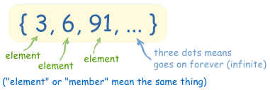
METHODS OF DESCRIBING A SET
ROSTER OR LISTING METHOD
The method describes the set by listing all elements of the set separated by commas and enclosed in braces .
A=

Slide 8
METHODS OF DESCRIBING A SET
RULE METHOD OR SET-BUILDER NOTATION
The method describes the set by enclosing a descriptive phrase of the elements in braces.
A= { x|x is a vowel in the alphabet}

Slide 9
EXAMPLE
 | Roster or Listing Method | Rule or Set Builder Notation
A is the set of items you wear | A= {socks, shoes, watches, shirts,….} | A={x|x is an item you wear}
B is set of types of finger | B= {index, middle, ring, pinky} | B={x|x is a type of finger}
B is the set of counting numbers between 2 and 7 | B={3, 4, 5, 6} | C={x|x is a month of the year that has 31 days}
D is the set of even numbers | D={.., -4, -2, 0, 2, 4, ..} | D={x|x is an even number}
E is the set of odd numbers | E= {..., -3, -1, 1, 3, ...} | E={x|x is an odd number}

Slide 10
 | Roster or Listing Method | Rule or Set Builder Notation
F is the set of prime numbers | F= {2, 3, 5, 7, 11, 13, 17, ...} | F={x|x is a prime number}
G is the set of positive multiples of 3 that are less than 10 | G= {3, 6, 9} | G={x|x is a positive multiples of 3 that is less than 10
C is the set of months of the year that has 31 days | C= {Jan, March, May, July, Aug, Oct, Dec } | C={x|x is a month of the year that has 31 days}
If P is the set of letters in the word ELEMENT | P={E, L, M, N, T} | D={x|x is a letter in the word ELEMENT}
D is the set vowels in the alphabet | D={a, e,i,o,u} | E={x|x is a vowel in the alphabet}
The vertical bar is read “such that” and x represents any element of the set.

Slide 11
CARDINALITY OF SET
The cardinality of a set S, denoted by n(S), or |S| is the number of distinct elements in the set.
KINDS OF SETS
A finite set is a set whose elements can be counted.
An infinite set is a set whose elements cannot be counted.
A null or empty set denoted by or { } is a set that has no element.
The universal set, denoted by U, is a set that contains all the elements in consideration.
Note: The cardinality of a null or empty set is zero.

Slide 12
EXAMPLE
 | CARDINALITY | KIND
A= {1, 2, 3, ...,20} | n (A)= 20 | finite
B= {index, middle, ring, pinky} | n (B)= 4 | finite
B={3, 4, 5, 6} | n (B)= 4 | finite
D={.., -4, -2, 0, 2, 4, ..} | n (D) =infinite | infinite
E= {..., -3, -1, 1, 3, ...} | n (E)=infinite | infinite
F= {2, 3, 5, 7, 11, 13, 17, ...} | n (F)= infinite | infinite
G is the set of prime numbers between 19 and 23 | n (G) = 0 | Null or { }
H= {0} | n (H) = 1 | finite
P={x|x is a perfect square integer between 10 and 15} | n (P) = 0 | Null or { }

Slide 13
SET RELATIONSHIPS
Two sets A and B are equivalent, denoted by if they have the same cardinality.
Two sets A and B are equal, denoted by A=B if the elements of A and B are exactly the same.
EQUIVALENT SETS | EQUAL SETS
{1,2,3,4,5} {a,b,c,d,e} | {1,2,3} = {2,1,3}
 | {x|x is the set of first four positive whole numbers}={4,2,1,3}
{x|x is a prime number less than 25} {1,2,3,4,5,6,7,8,9} | {r, a,t} = {a,r,t}
NOTE: Equal sets are always equivalent but equivalent sets are not always equal.

Slide 14
SET RELATIONSHIPS
Two sets A and B are joint if and only if A and B have common elements; otherwise, A and B are disjoint.
EXAMPLE
A and B are joint sets
B and C are joint sets
A and C are disjoint sets
,

Slide 15
SET RELATIONSHIPS
.
Set A is a subset of set of B, denoted by , if and only if every element of A is an element of B.
If there is an element of set A which is not found in set B, then
A is not a subset of B, denoted by .
/
EXAMPLE
Let A be all multiples of 4 and B be all multiples of 2. Is A a subset of B? And is B a subset of A?

Slide 16

SET RELATIONSHIPS
The sets are:
A = {..., -8, -4, 0, 4, 8, ...}
B = {..., -8, -6, -4, -2, 0, 2, 4, 6, 8, ...}
By pairing off members of the two sets, we can see that every member of A is also a member of B, but every member of B is not a member of A.
A is a subset of B, but B is not a subset of A
or
/

Slide 17
A is a proper subset of B denoted by if and only if every element in A is also in B, and there exists at least one element in B that is not in A.
SET RELATIONSHIPS
{1, 2, 3} is a subset of {1, 2, 3}, but is not a proper subset of {1, 2, 3}
or
{1, 2, 3} is a proper subset of {1, 2, 3, 4} because the element 4 is not in the first set
or
NOTE:
If A is a proper subset of B, then it is also a subset of B
The empty set is a subset of every set, including the empty
set itself.

Slide 18
The power set of A, denoted by , is the set whose elements are all the subsets of A.
SET RELATIONSHIPS
A null set is a subset of any given set.
Any set is a subset of itself.
There are subsets, where n is the number of elements, that can be formed for any given set.

Slide 19
VENN DIAGRAM
Venn Diagram is the pictorial representation in dealing with the relations between sets, after the English logician James Venn.
U
A
B
A and B are disjoint sets.
/
/

Slide 20
U
B
A

Slide 21
U
A
B

Slide 22
A
B
A and B are joint sets

Slide 23
OPERATIONS ON SETS

Slide 24
UNION OF SETS
The union of two sets A and B, denoted by , is the set whose elements belong to A or to B or to both A and B. In symbol,
EXAMPLE

Slide 25
INTERSECTION OF SETS
The intersection of two sets A and B, denoted by , is the set whose elements are common to A and B. In symbol,
EXAMPLE
Two sets are disjoint if their intersection is an empty or null set.

Slide 26
COMPLIMENT OF A SET
The complement of set A, denoted by A’, is the set with elements found in the universal set, but not in A; that is, the difference of the universal set and A. In symbol,
EXAMPLE

Slide 27
DIFFERENCE OF SETS
The difference of two sets A and B, denoted by A - B, is the set whose elements are in A but not in B, In symbol,
EXAMPLE

Slide 28
CARTESIAN PRODUCT OF SETS
The Cartesian product of two sets A and B, denoted by A x B , is the set of ordered pairs such that x is an element of A and y is an element of B. In symbol,
EXAMPLE

Slide 29
VENN DIAGRAM
In the Venn diagram below, the shaded region represents the indicated operation.
A
B

Slide 30
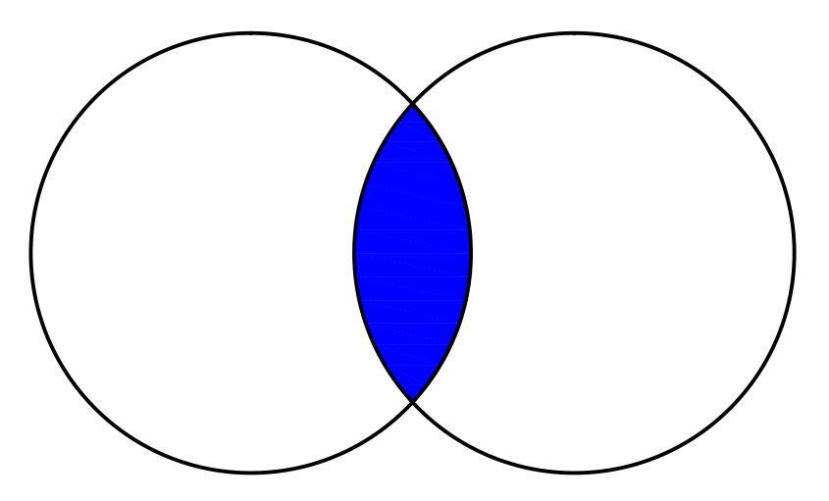
VENN DIAGRAM
In the Venn diagram below, the shaded region represents the indicated operation.
A
B

Slide 31
VENN DIAGRAM
In the Venn diagram below, the shaded region represents the indicated operation.
A
B

Slide 32
EXAMPLE
Using Venn diagram, illustrate the given set by shading the region it represents.
A
B
C
A
B
C

Slide 33
A
B
C

Slide 34
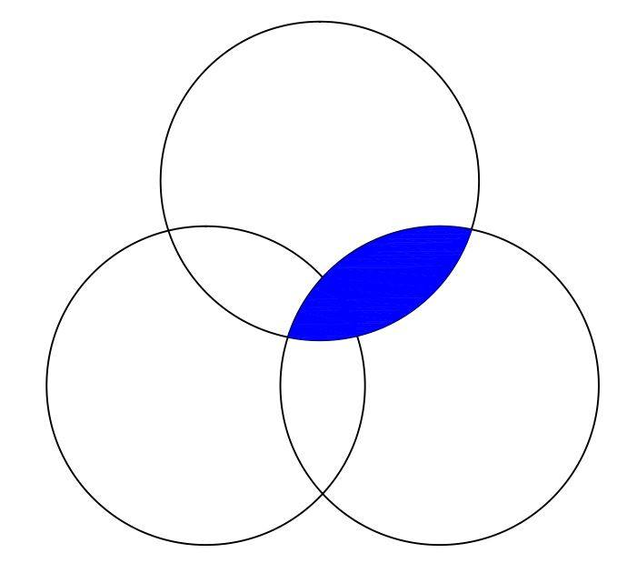
EXAMPLE
Using Venn diagram, illustrate the given set by shading the region it represents.
A
A
B
C
C
B

Slide 35
A
B
C

Slide 36
Solve each of the following problems.
1. In a survey concerning the number of students enrolled in Mathematics, it was found out that 30 are enrolled in Algebra, Calculus and Trigonometry; 40 in Algebra and Trigonometry; 45 in Trigonometry and Calculus; 50 in Algebra and Calculus; 80 in Algebra; and 70 in Calculus. If there are 130 students in all, how many students are enrolled in Trigonometry?
2. At ABC supermarket shoppers were asked what brand of detergent bars {X, Y , Z} they use. The following responses were gathered: 41 use brand X, 27 use brand Y, 32 use brand Z, 24 use both brands X and Z , 20 use both brands X and Y, 18 use both brands Y and Z, and 16 use all the three. How many use a) brands X and Y and not brand Z, b) brands X and Z and not brand Y, c) brands Y and Z and not brand X, d) brand X only, e) brand Y only, and f) brand Z only. How many of the shoppers interviewed use at least one of the three brands?

Slide 37
2. In a survey among moviegoers’ preferences, 60% like fiction, 55% like drama, 56% like comedy, 25% like fiction and drama, 30% like fiction and comedy, 26% like comedy and drama, and 5% like fiction, drama and comedy. Only 5% of the respondents do not prefer any types of movies mentioned.
a. Draw a Venn Diagram corresponding to the given data.
b. What are the percentages of moviegoers who prefer
1. comedy but not fiction?
2. drama only?
3. fiction or comedy but not drama?
4. comedy and drama but not fiction?

Slide 38
REAL NUMBER SYSTEM

Slide 39
ELEMENTS OF THE SET OF REAL NUMBER
In mathematics it is useful to place numbers with similar characteristics into sets.
All the numbers in the Number System are classified into different sets and those sets are called as Number Sets.
A real number is any element of the set R, which is the union of the set of rational numbers and the set of irrational numbers. The set R gives rise to other sets such as the set of imaginary numbers and the set of complex numbers.
The real number system is fundamental in the study of algebra .
The set of real numbers is divided into natural numbers, whole numbers, integers, rational numbers, and irrational numbers. These sets of numbers are used extensively in the study of algebra.

Slide 40
SET | DESCRIPTION
Natural numbers (N) | Set of the counting numbers 1, 2, 3, 4 and so on.
Whole numbers (W) | Set of the natural numbers and zero
Integers (Z) | Set of natural numbers along with their negatives and zero (e.g. -3, -2, -1, 0, 1, 2, 3).
Rational numbers (Q) | Set of real numbers that are ratios of two integers (with nonzero denominators). A rational number is either a terminating decimal or a non-terminating but repeating decimal.

Slide 41
SET | DESCRIPTION
Irrational numbers (I) | Set of non-terminating, non-repeating decimals. Irrational numbers are numbers which cannot be expressed as quotient of two integers.
Real numbers (R) | The union of the sets of rational numbers and irrational numbers

Slide 43
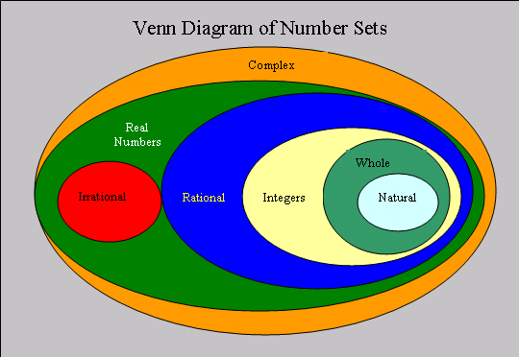

Slide 44

The Real Number Line is like an actual geometric line.
A point is chosen on the line to be the "origin", points to the right will be positive, and points to the left will be negative.

Slide 45
PROPERTIES OF REAL NUMBERS

Slide 46
BASIC PROPERTIES OF REAL NUMBERS
PROPERTY | ADDITION | MULTIPLICATION
Closure
Commutative
Associative
Distributive
Identity
Inverse
0 is the identity element for addition and 1 is the identity element for multiplication.
-a is the additive inverse of a and is the multiplicative inverse.

Slide 47
PROPERTIES OF ORDER OF REAL NUMBERS
Let a, b and c be real numbers. The following properties of order of real numbers hold.
PROPERTY | DESCRIPTION
Trichotomy Property of Order | Among a<b, b<c, a=b only one is true.
Transitive Property of Order | If a<b and b<c, then a<c
Addition Property of Order | If a<b, then a+c < b+c
Multiplication Property of Order: | If a<b and c>0, then ac<bc If a<b and c<0, then ac>bc

Slide 48
PROPERTIES OF EQUALITY
Let a, b and c be real numbers. The following properties of equality hold.
PROPERTY | DESCRIPTION
Reflexive Property | a = a
Symmetric Property | If a = b, then b = a.
Transitive Property | If a = b and b = c, then a = c.
Substitution Property | If a = b, then a can be replaced by b in any statement involving a or b.

Slide 49
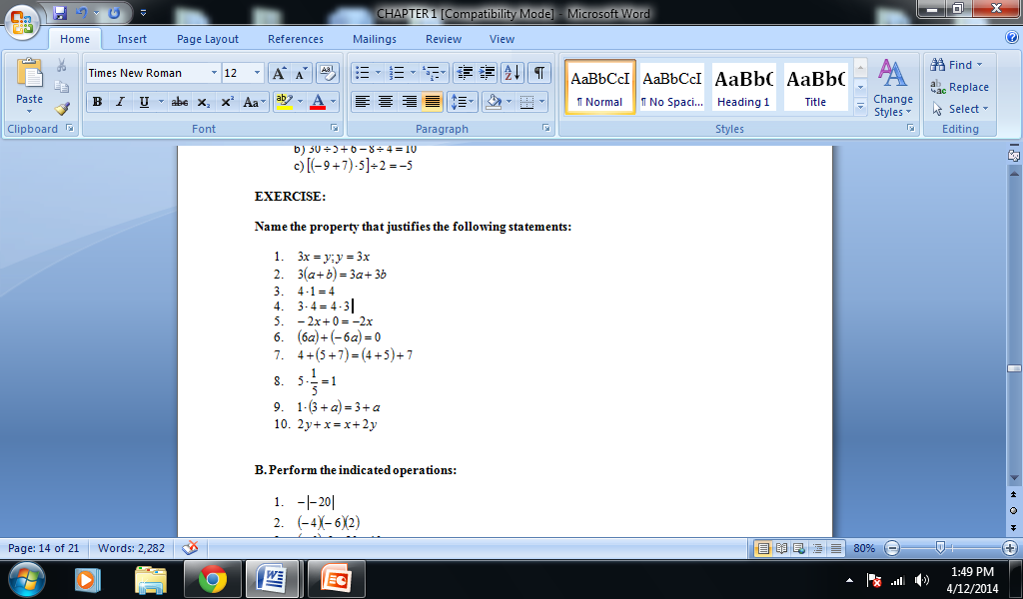

Slide 50
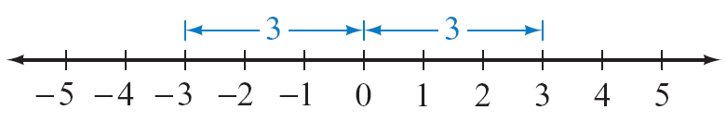
ABSOLUTE VALUE OF NUMBERS
Every real number corresponds to a point on the number line, and every point on the number line corresponds to a real number.
The absolute value of a real number a, denoted | a |, is the distance between a and 0 on the number line.
For instance, | 3 | = 3 and | –3 | = 3 because both 3 and –3 are 3 units from zero.

Slide 51
Definition of Absolute Value
The absolute value of the real number a is defined by

Slide 52
EXAMPLE
| 5 | = 5 | –4 | = 4 | 0 | = 0
Note:
The second part of the definition of absolute value states that if a < 0, then | a | = – a. For instance, if a = – 4, then | a | = | – 4 | = –(– 4) = 4.

Slide 53
ORDER OF OPERATIONS AGREEMENT
The Order of Operations Agreement
If grouping symbols are present, evaluate by first performing the operations within the grouping symbols, innermost grouping symbols first, while observing the order given in steps 1 to 3.
Step 1 Evaluate exponential expressions.
Step 2 Do multiplication and division as they occur from left to right.
Step 3 Do addition and subtraction as they occur from left to right.
We call this as the PEMDAS RULE

Slide 54
EXAMPLE
Evaluate: 5 – 7(23 – 5²) – 16 ÷ 2³
Solution:
= 5 – 7(23 – 25) – 16 ÷ 2³
= 5 – 7(–2) – 16 ÷ 2³
= 5 – 7(– 2) – 16 ÷ 8
= 5 – (–14) – 2
= 17
Begin inside the parentheses and evaluate 5² = 25.
Continue inside the parentheses and evaluate 23 – 25 = –2.
Evaluate 2³ = 8.
Perform multiplication and division from left to right.
Perform addition and subtraction from left to right.

Slide 55
Evaluate: 3  5² – 6(–3² – 4²) ÷ (–15)
Solution:
= 3  5² – 6(–9 – 16) ÷ (–15)
= 3  5² – 6(–25) ÷ (–15)
= 3  25 – 6(–25) ÷ (–15)
= 75 + 150 ÷ (–15)
= 75 + (–10)
= 65
Begin inside the parentheses.
Simplify –9 – 16.
Evaluate 5².
Do multiplication and division from left to right.
Do addition.

